Slide 1
Software Project Lab – 1 Final Presentation
Project Title: ImCloneDetect (Image-Based Code Clone Detection Tool)
Student Details:
Md. Tawrat Hossen Nibir
Roll: BSSE 1625
Institute of Information Technology (IIT)
University of Dhaka
Supervisor Details:
Toukir Ahammed
Lecturer
Institute of Information Technology (IIT)
University of Dhaka

Slide 2
Project Description – “What?”
Tool Development
Develop an Image-Based Code Clone Detection Tool designed for precision and efficiency.

Slide 3
Project Description – “How?”
Core Algorithms
Image Similarity
Utilize Jaccard Distance [1], Perceptual Hash (pHash) [1], and Earth Mover's Distance (EMD) [2].
Detect similarities among source code images (BMP files) using advanced algorithms.
Output & Visualization
Generate similarity results in CSV files and display them in the terminal, enabling visualization in future.

Slide 4
What I Had Implemented Till Midterm…
BMP image file handling
.bmp format images
Methods and constructors for reading and writing .bmp files
Properly handling exceptions thrown by the file operations

Slide 5
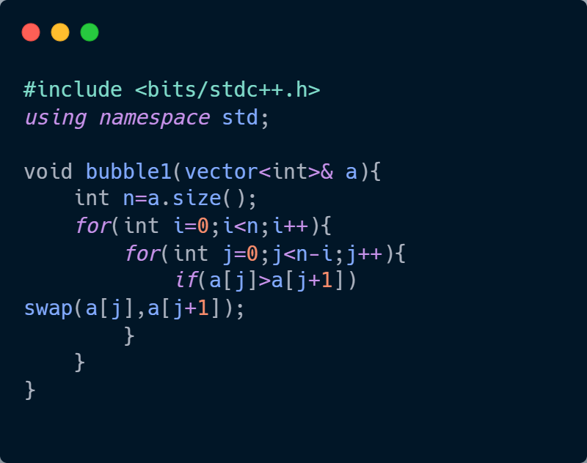
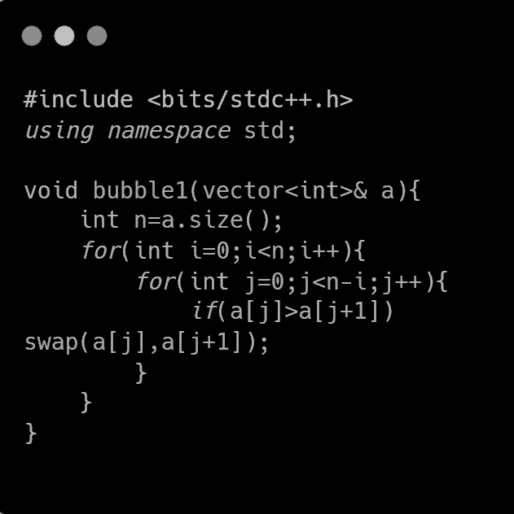
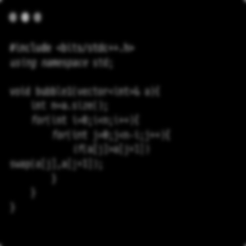
What I Had Implemented Till Midterm…
Normalization
Grayscale image generation
Gaussian blur image generation using ‘Gaussian kernel’
Negative image generation
Pixel vector extraction
Image resizing using ‘Bilinear Interpolation’
Colorful Image
Grayscale Image
Resized Image
Gaussian Blur Image

Slide 6
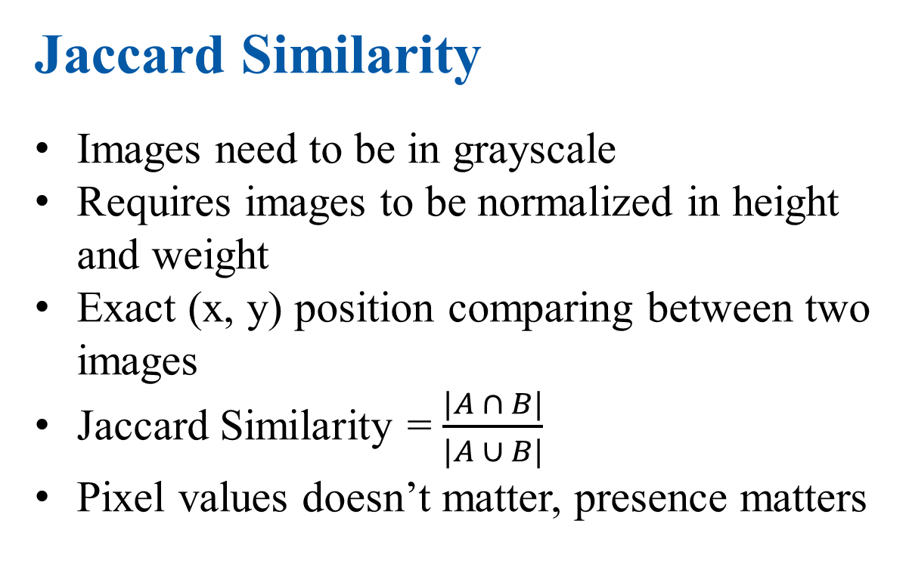
What I Had Implemented Till Midterm…
Jaccard Similarity
Images need to be in grayscale
Requires images to be normalized in height and weight
Exact (x, y) position comparing between two images
Jaccard Similarity = $\frac{|A ∩ B|}{|A ∪ B|}$
Pixel values doesn’t matter, presence matters
A = Nonzero pixels in image1
B = Nonzero pixels in image2
Nonzero pixels in both A and B

Slide 7

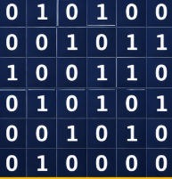
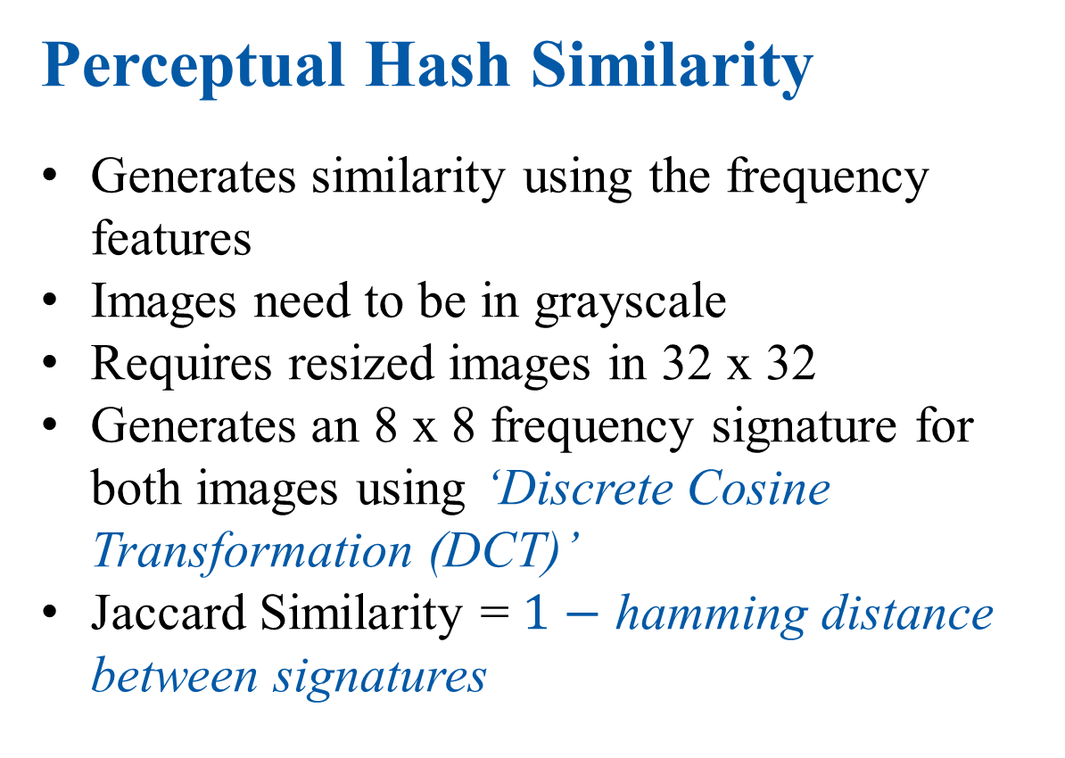
What I Had Implemented Till Midterm…
Perceptual Hash Similarity
Generates similarity using the frequency features
Images need to be in grayscale
Requires resized images in 32 x 32
Generates an 8 x 8 frequency signature for both images using ‘Discrete Cosine Transformation (DCT)’
Jaccard Similarity = $1−$ hamming distance between signatures
32 x 32 image
32 x 32 DCT
Hash signature:
010100001011100110010101001010010000
Top-left 8x8 grid

Slide 8

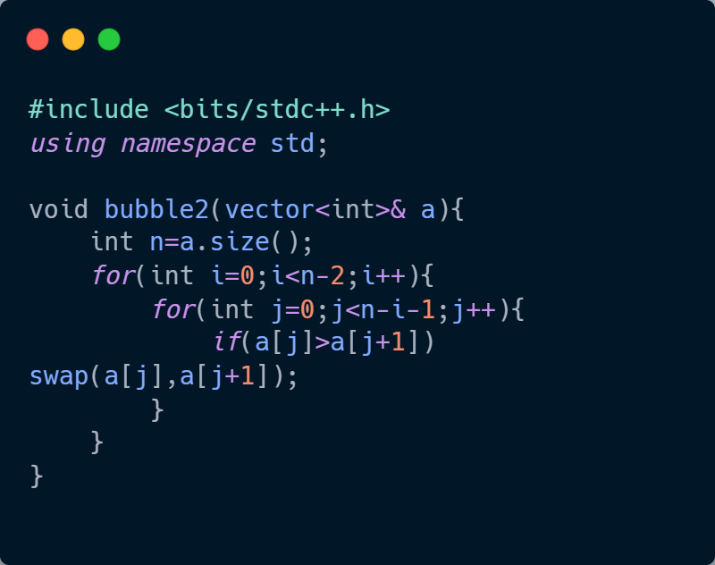
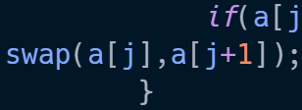

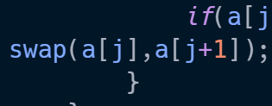

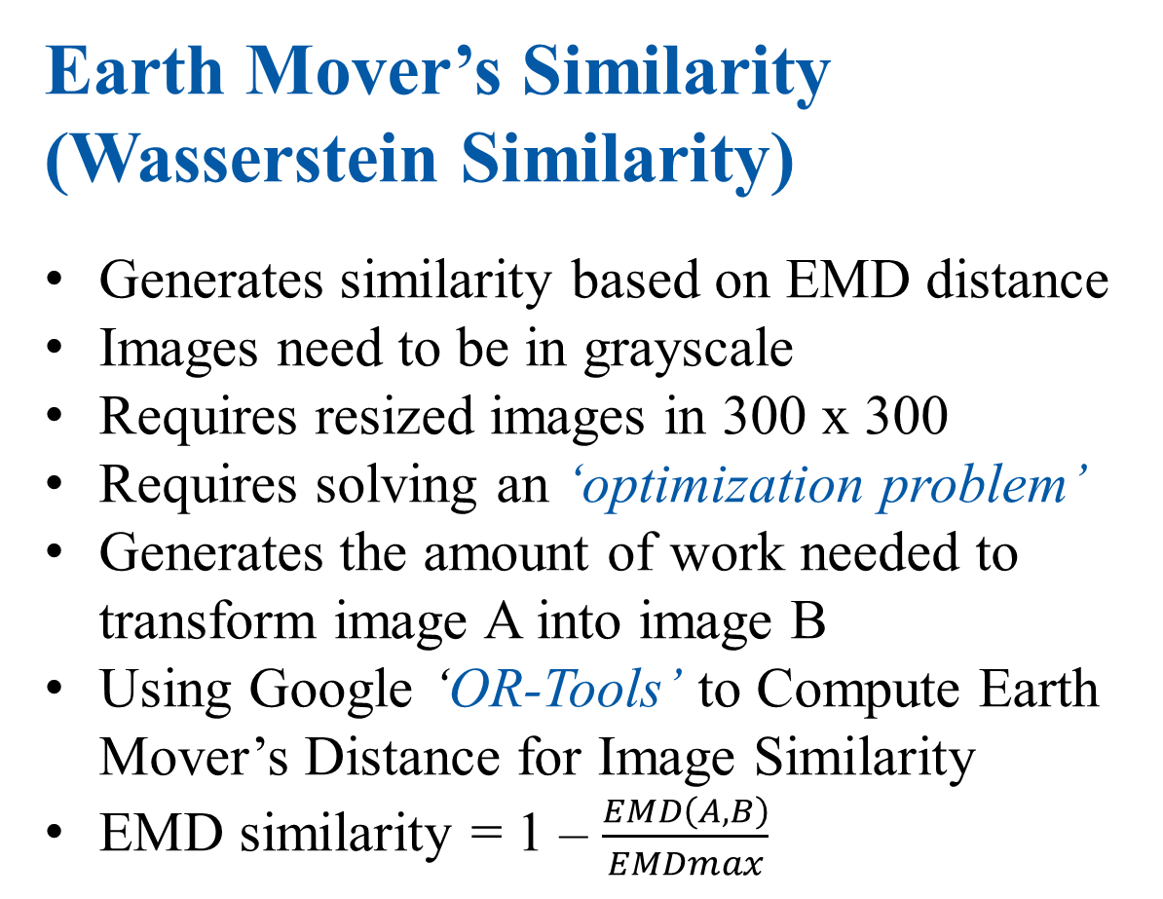
Post-mid Implementation
Earth Mover’s Similarity
(Wasserstein Similarity)
Generates similarity based on EMD distance
Images need to be in grayscale
Requires resized images in 300 x 300
Requires solving an ‘optimization problem’
Generates the amount of work needed to transform image A into image B
Using Google ‘OR-Tools’ to Compute Earth Mover’s Distance for Image Similarity
EMD similarity = 1 – $\frac{EMD\left(A,B\right)}{EMDmax}$
How Earth Mover’s Distance help finding similarities

Slide 9
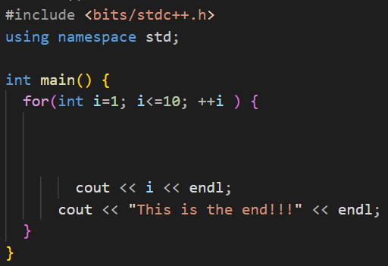
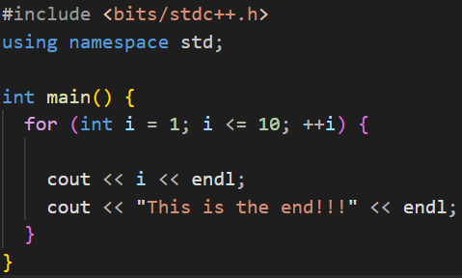
Post-mid Implementation
Clang-formatter
Clang-formatter used as linter to format codes before taking images
Implemented as an extension for the project
Clang-formatter applied

Slide 10
Features Implemented
Interactive user-friendly menu
Directory based pairwise similarity scores
Single pair similarity score
Jaccard distance-based similarity
Bilinear interpolation to resize images
Gaussian kernel to generate blur images
Discrete Cosine Transformation (DCT) to generate perceptual hash-based similarity
Earth Movers Distance by solving a min-flow problem
Linter for formatting the code files to be taken images
CSV file generation containing file pairs and similarity score
GEXF file generation for visualization
Customizable weight for different similarity-based algorithms
Directory independent similarity generation

Slide 11
Work Flow
Input Images
(Under the
assumptions)
Normalization
(Padding and
scaling)
Gray-scaling
Gaussian blur
Output
GEXF files
(For visualization
With Force Atlas 2)
Output
CSV files
(With similarity
Scores of files)
Similarity
Algorithms
(Jaccard [1], p-Hash [1],
EMD [2])

Slide 12
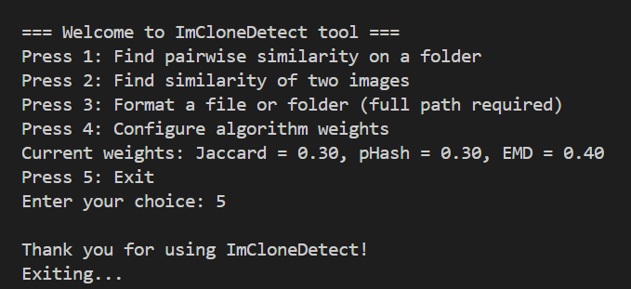
Project Screenshots
Intro Screen with interactive menu

Slide 13
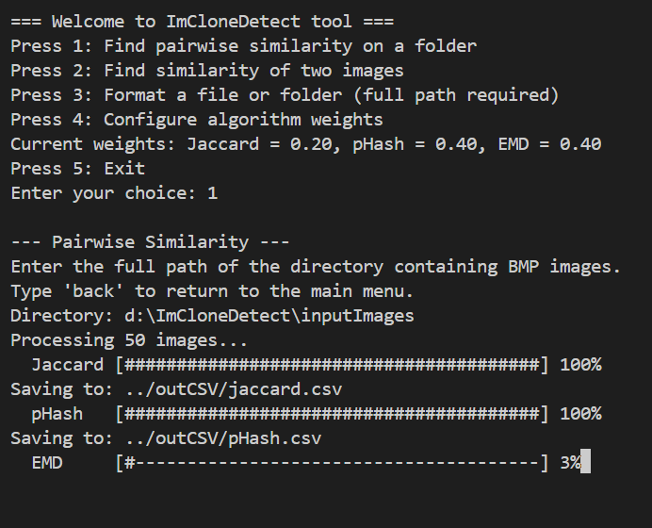
Project Screenshots
Directory based similarity generation

Slide 14
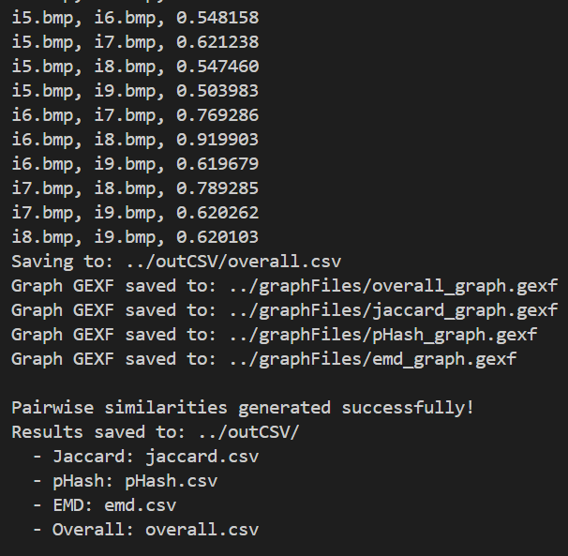
Project Screenshots
Similarities shown on console and .csv and .gexf stored on directories for further visualization

Slide 15
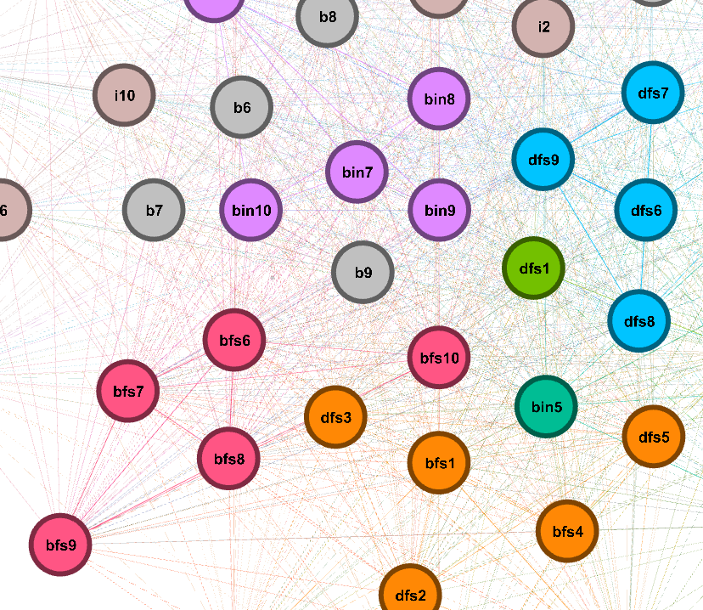
Project Screenshots
Similar Codes!!!
.gexf files visualized on Gephi Graph visualizer using Modularity Class and Force Atlas 2 algorithm

Slide 16
Thank you

Slide 17
References
[1] Y. Wang and D. Liu, “Image-Based Clone Code Detection and Visualization,” 978-1-7281-4691-1/19/$31.00 ©2019 IEEE DOI 10.1109/AIAM48774.2019.00041, pp. 168–175, Oct. 2019, doi: 10.1109/aiam48774.2019.00041.
[2] C. Ragkhitwetsagul, J. Krinke, and B. Marnette, “A picture is worth a thousand words: Code clone detection based on image similarity,” 978-1-5386-6430-8/18 © 2018 IEEE IWSC 2018, Campobasso, Italy. Accepted 10.1109/iwsc.2018.8327318.
[3] https://solarianprogrammer.com/2018/11/19/cpp-reading-writing-bmp-images/
BMP images normalization
[4] https://www.geeksforgeeks.org/dsa/discrete-cosine-transform-algorithm-program/
Discrete Cosine Transformation on the image for pHash similarity
[5] https://www.geeksforgeeks.org/maths/what-is-bilinear-interpolation/
Bilinear Interpolation for resizing the images to desired dimension

Slide 18
References
[6] https://docs.gephi.org/desktop/User_Manual/Import/GEXF_File_Format/
Format used to generate GEXF files
[7] https://developers.google.com/optimization/introduction/cppopers
Or-tools used to solve the min-flow problem in EMD

Slide 19
Github Repository Link
https://github.com/tawratnibir/SPL-1-ImCloneDetect

